Slide 1
Monitoring field-scale soil erosion patterns and mechanisms
Jessica Nelson
12/15/2021
Prepared for: EEOB590A Final Project

Slide 2

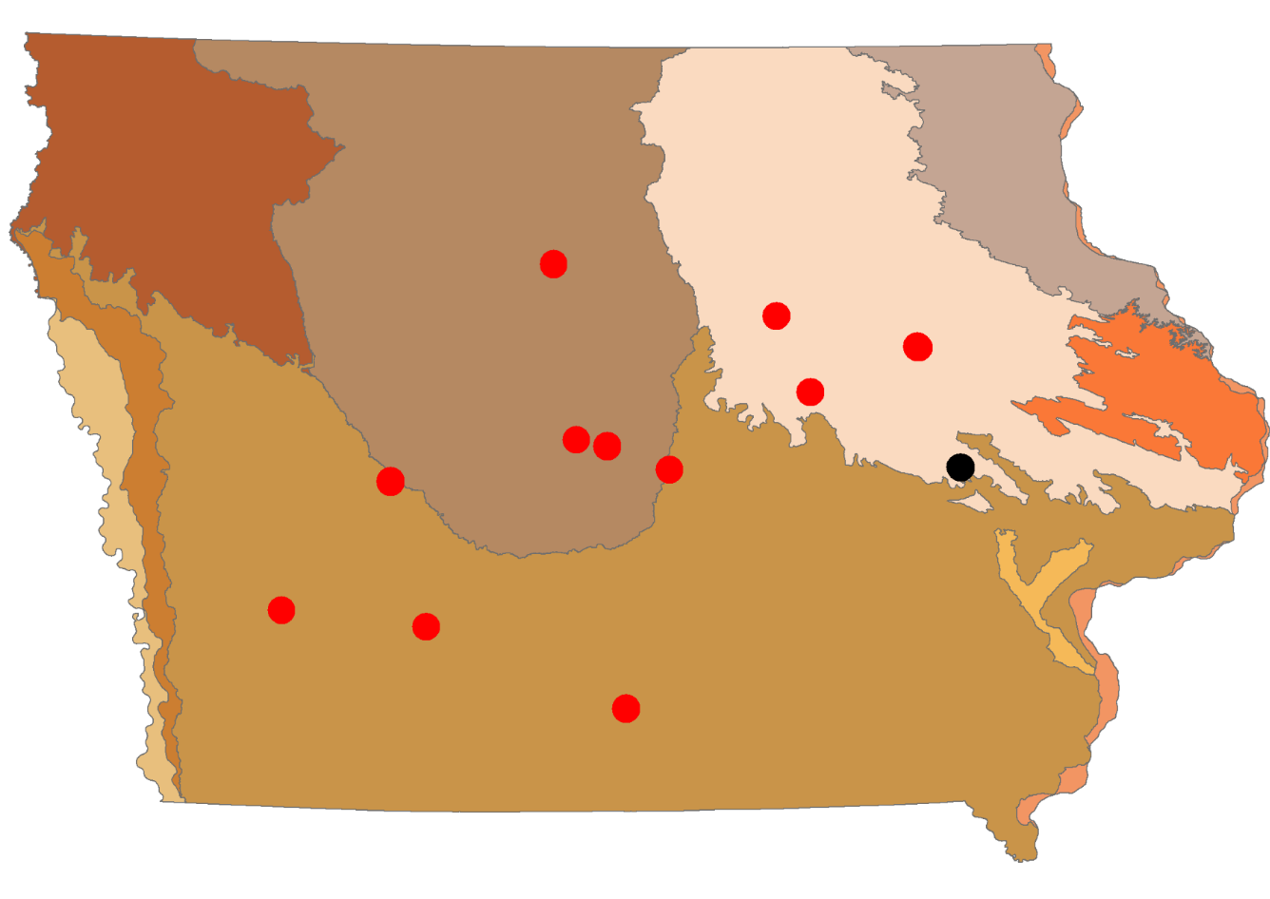
1. Effect prairie strips have on field-scale soil movement patterns in row crop systems in Iowa, U.S.

Slide 3
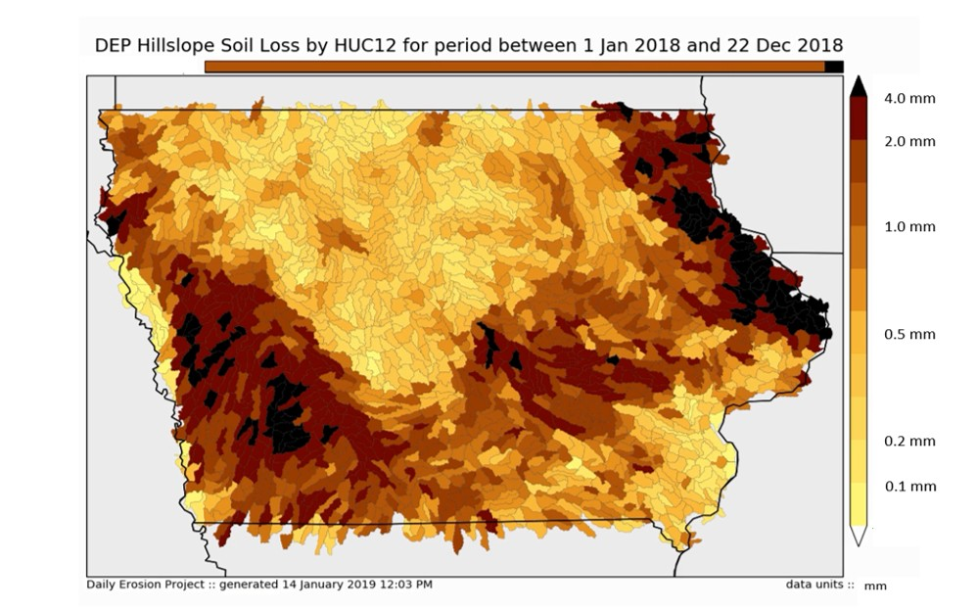
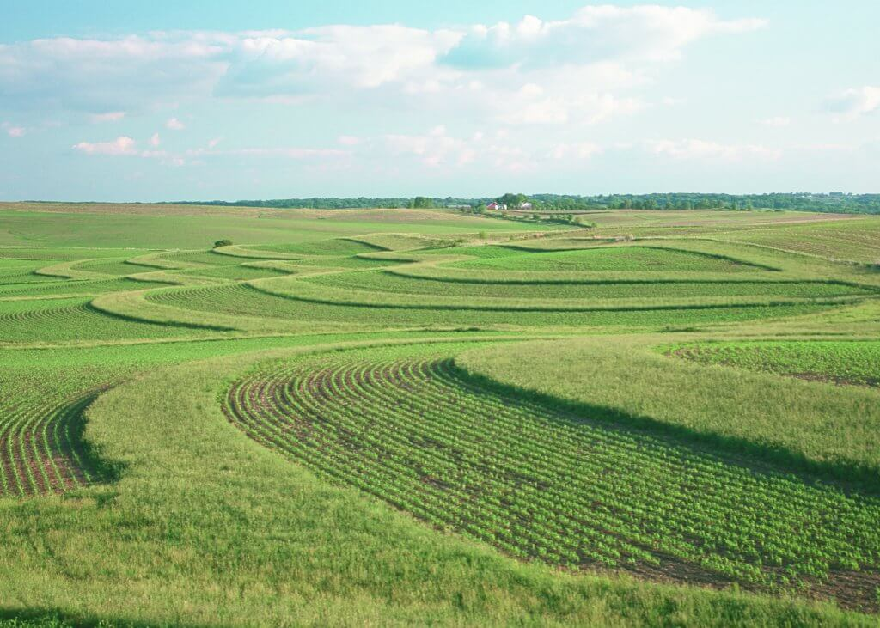
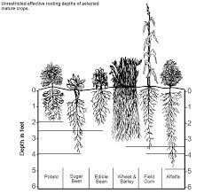
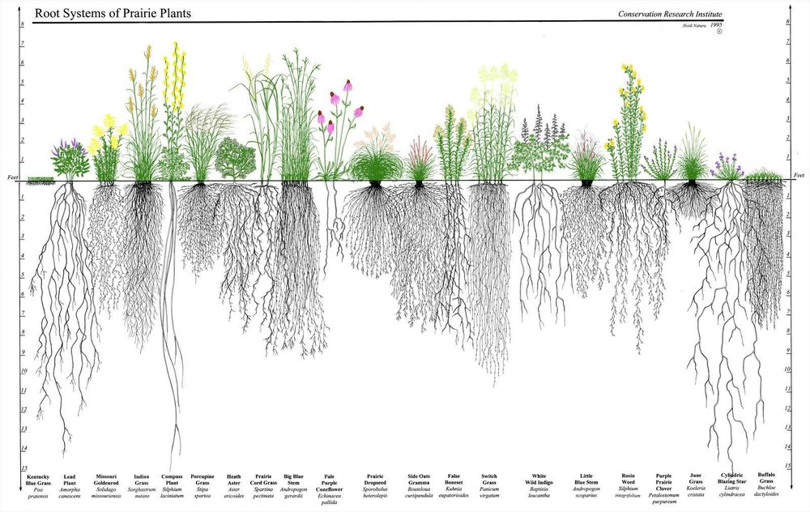


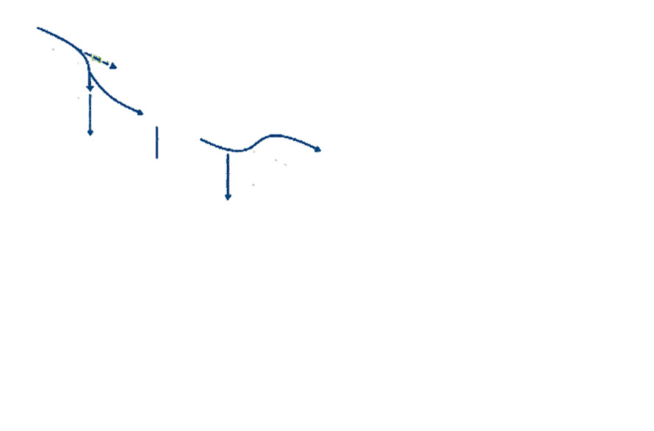



Background: Soil Erosion & Prairie Strips
US Midwest region is dominated by agroecosystems (43% in corn/soybean rotation).
- DEP estimate for Iowa: ~12.8 Mg ha⁻¹ yr⁻¹ (Cruse 2016)
- 70% of Iowa soils soil loss tolerance: ~11.2 Mg ha⁻¹ yr⁻¹ (NRCS)
- Soil regeneration rate: <0.4 Mg ha⁻¹ yr⁻¹ (Logan 1982)
There are 3 mechanisms driving movement and loss of soil: Detachment, transport and deposition.
Prairie Strip (CP-43) is a recent advancement in agriculture that provides a myriad of ecosystem services.
- Implemented along the contour of a field to intercept pollutant loads and runoff perpendicular to flow paths
- Diverse native prairie seed mix
- Ranges from 30-120 ft. in width
Corn
Overland Flow
Prairie Strip Vegetative Buffer
Source: Sustainability Community 2019
DEP: https://www.dailyerosion.org/
Corn
Interflow
Infiltration
Notes:
https://www.cleanlakesalliance.org/buffer-strips/contour-buffer-strip/
https://seedinnovation.ca/wp-content/uploads/2017/11/Vegetative-Buffers-Whitepaper.pdf
https://www.hrwc.org/take-action/at-home/lawn-garden/
Contour buffer strip diagram + filter strip research
INTERCEPT FLOW PATHS AND SHORTEN THE LENGTH TO REDUCE THE FORCE/ENERGY
Source: Data collected by STRIPS team between 2007-2014 at Neal Smith National Wildlife Refuge as reported in Schulte et al. 2017. PNAS. 201620229.
Traditional - Contour Buffer Strips CP332 (monoculture of cool season grasses; ~37% reduction in water runoff, average 85% reduction in sediment; Lenhart et al. 2017)

Slide 4
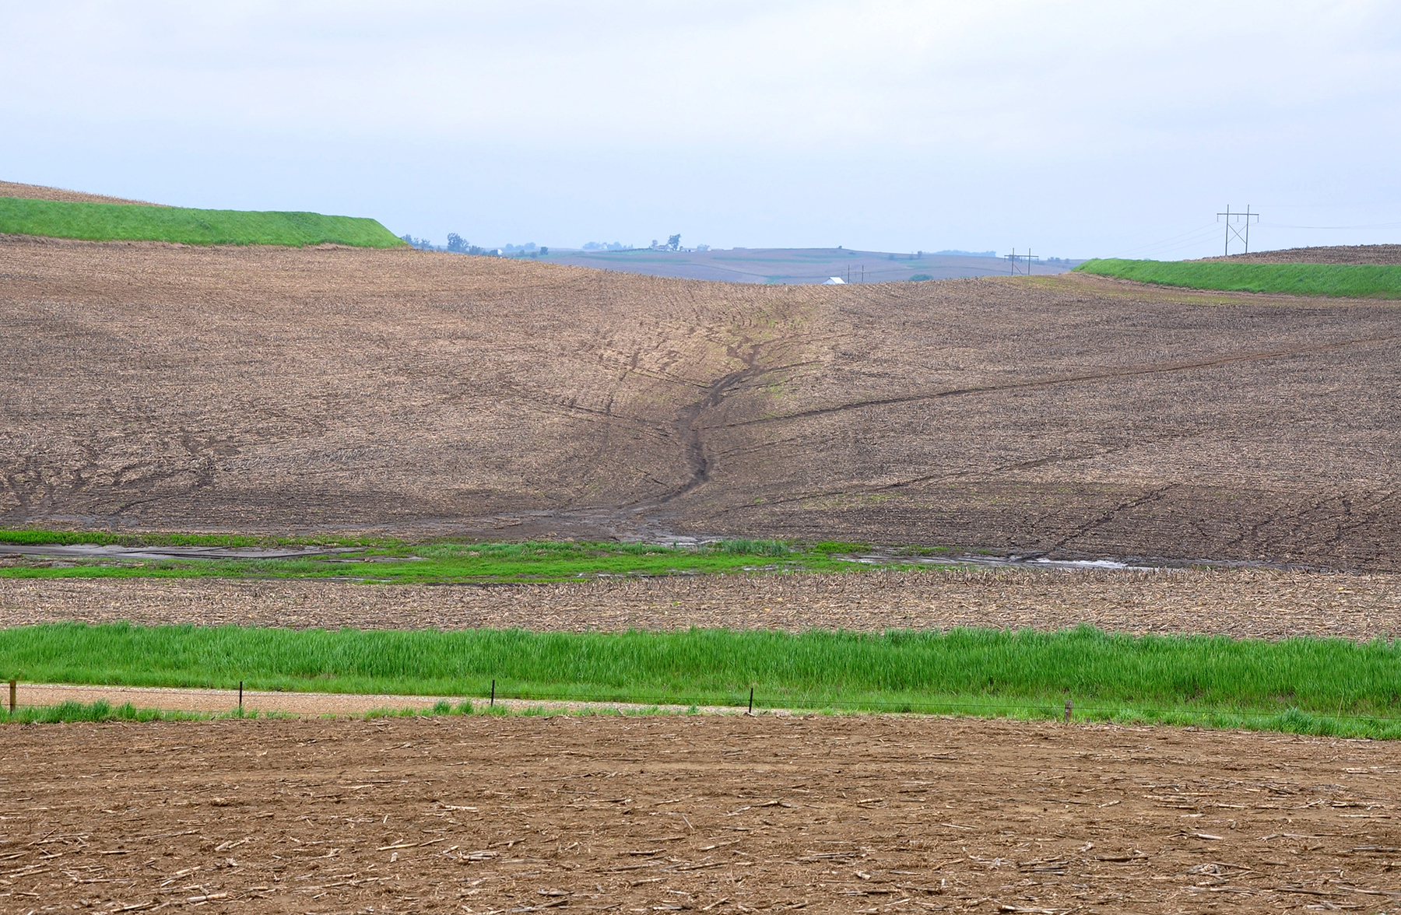
2. Monitoring field-scale soil movement using mesh pad method
Notes:
Ask Rick for permission to use this image

Slide 5
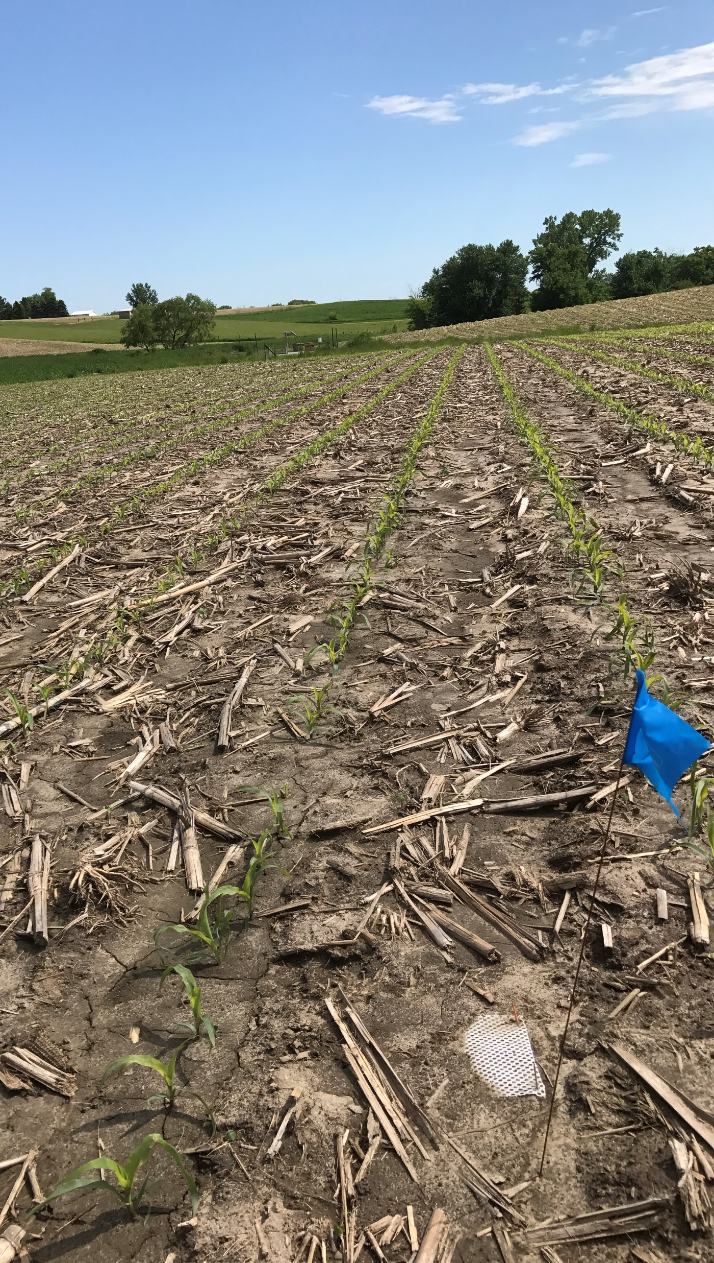
Background: Mesh Pad Method
Small pads (100-900 cm²) of fabric fastened to the earth’s surface throughout a field with two layers:
i. Top Layer = Nylon mesh (pore ~ 4 mm)
ii. Bottom Layer = Noseeum netting (pore ~ 0.1 mm)
Water is allowed to move through the pad, while the pore size of the Noseeum base layer prevents soil particles >0.1 mm to infiltrate.
Positively correlated with runoff plot methods and assesses greater amounts of total soil erosion (detachment + transport) (Hsieh et al. 2009).
Notes:
The mesh pad method was positively correlated with commonly deployed runoff plot methods (Hsieh et al. 2009).

Slide 6
Methods: Experimental Design and Tools
Approach: Paired watershed
6 replicates (i.e., 6 paired watersheds; 12 fields).
A pair compared a watershed with strips of native prairie vegetation to watersheds without prairie.
Each watershed was either in corn or soybeans.
Equipment: H-flume and mesh pad method.
Analysis performed using Google Colab using rpy2 (v3.4.5) and R (v4.1.2)
Data Wrangling & Exploration ~ tidyverse (v1.3.1), data.table (v1.14.2), stringr (v1.4.0), ggplot2 (v3.3.5), purr (v0.3.4)
Data Analysis & Graphs ~ lme4 (v1.1-27.1), lmerTest (v3.1-3), ggResidpanel (v0.3.0), emmeans (v1.7.1-1), ggplot2 (v3.3.5)

Slide 7
Methods: Analysis
Response variable: Total Suspended Solids (TSS; ppm) and soil movement (rate of soil movement per day)
Main factors: Site, treatment, watershed position, and time
Linear mixed effects model
TSS loads summed over year, site and treatment (March-November), and TSS loads summed for only dates that fell within mesh pad method sampling period (April-August).
Rate of soil movement average over year, site and treatment for sample periods between 2016-2019.
Means were calculated and plotted with emmeans, and averaged over year, site, and treatment.
Contrasts performed to evaluate treatment effect observed at H-flume and deploying mesh pads.
Regression analysis performed to compare soil movement measured at H-flume and using mesh pads.

Slide 8
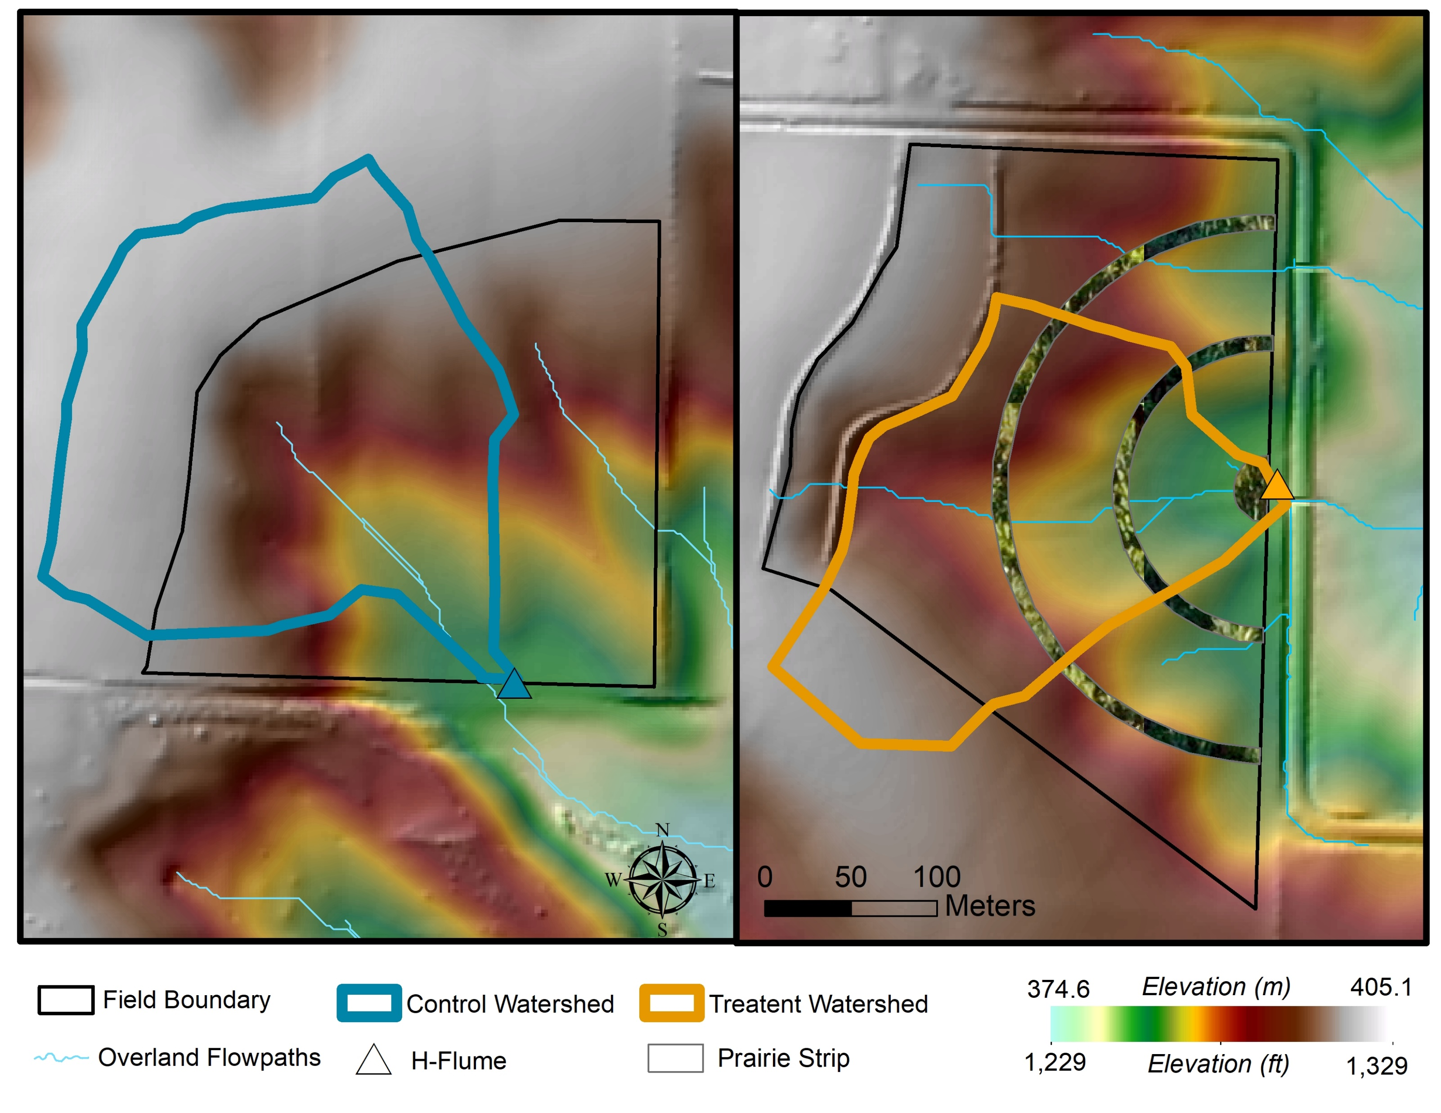
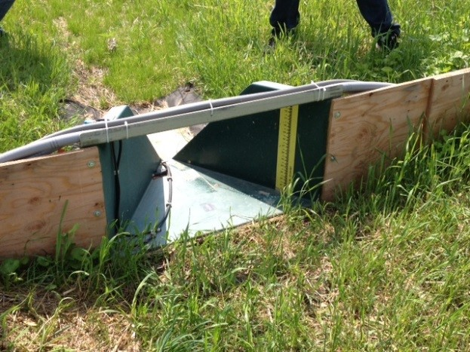
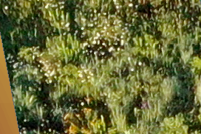
Methods: H-Flume
Control
Treatment
Total Suspended Solids (TSS) Loads:
-6 paired watersheds (2016-2020)
- 1 H-flume / watershed outlet
- Water samples summed to daily flow and TSS loads
- Between freeze dates
(H-flume data collected by Helmers Lab at ISU)
Notes:
Take out pad drainage area
Diversion dots removed
Mute DEM so it is less bright

Slide 9
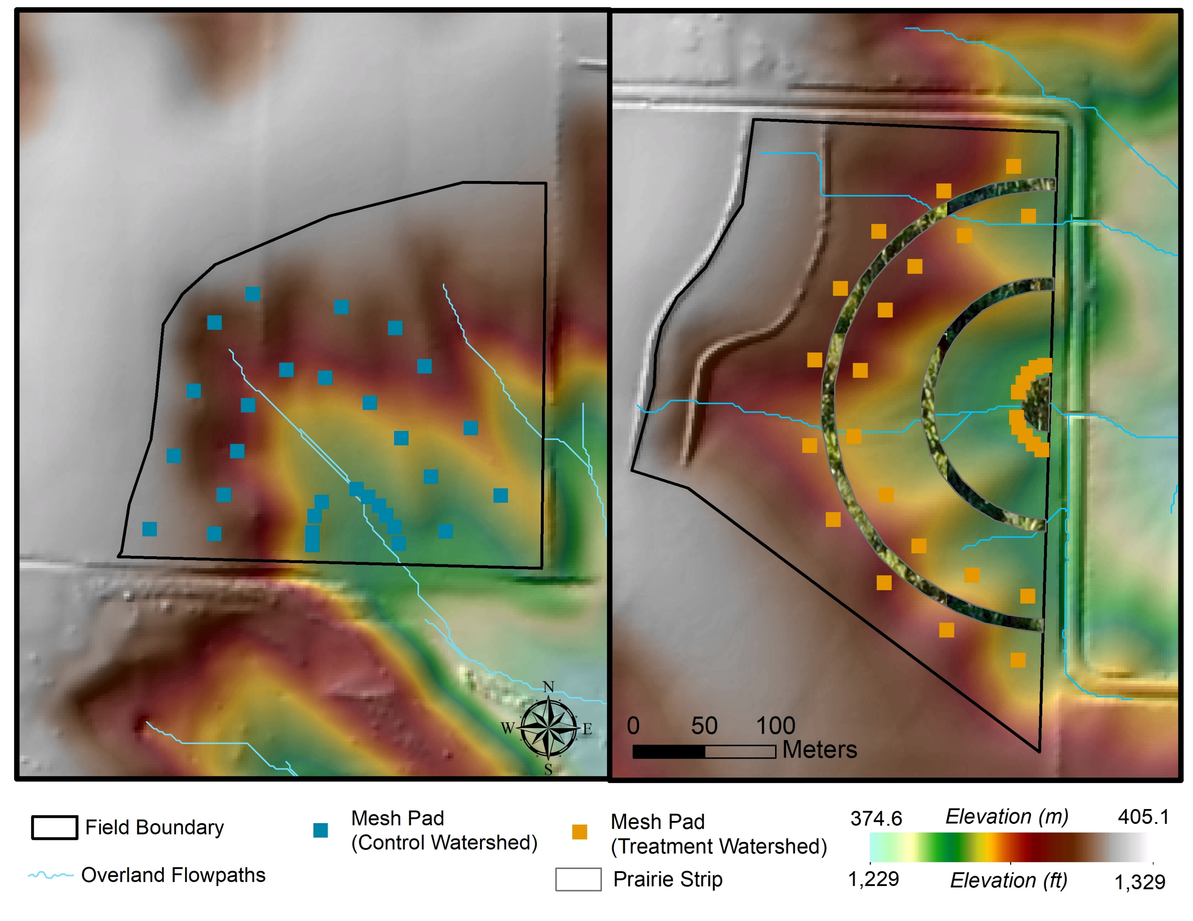
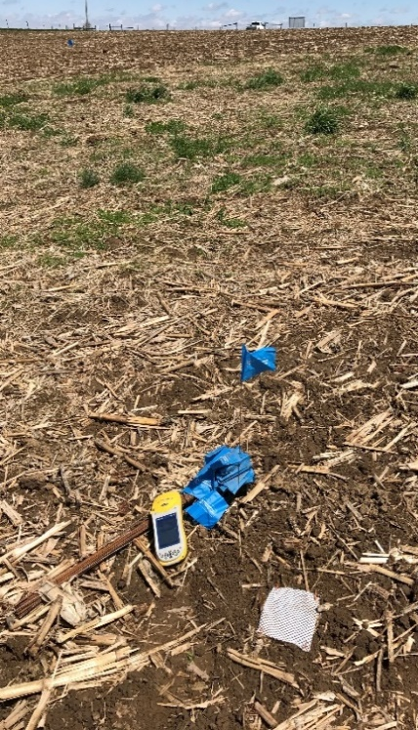
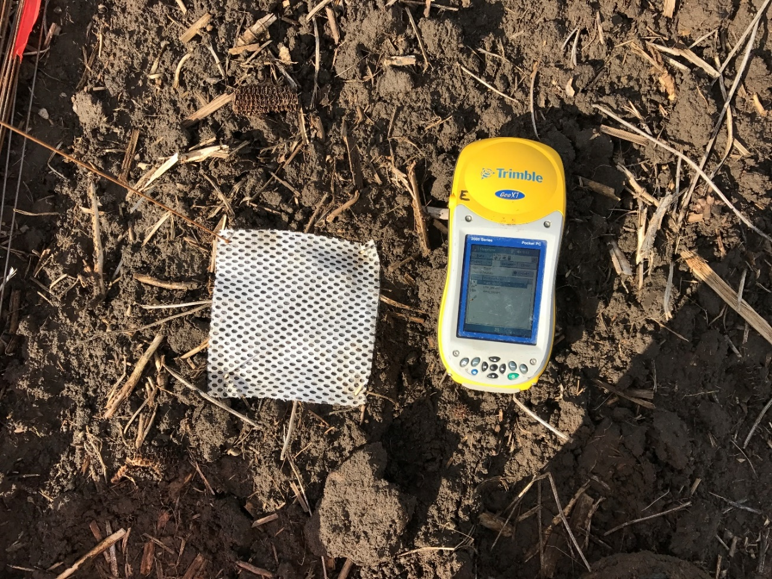
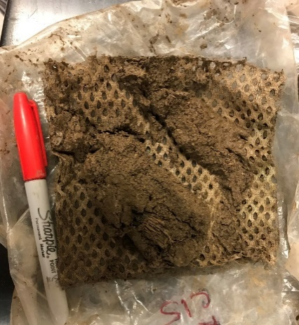
Methods: Mesh Pad
Control
Treatment
In-field soil displacement patterns using 15x15 cm mesh pads:
-12 paired watersheds (2016-2020)
- 3 landscape positions / watershed
- 10 pads / position
- ~3 observational periods / year / pair
- Growing season
Total pads: 5,892
15 cm
15 cm
Notes:
Take out pad drainage area
Diversion dots removed
Mute DEM so it is less bright

Slide 10
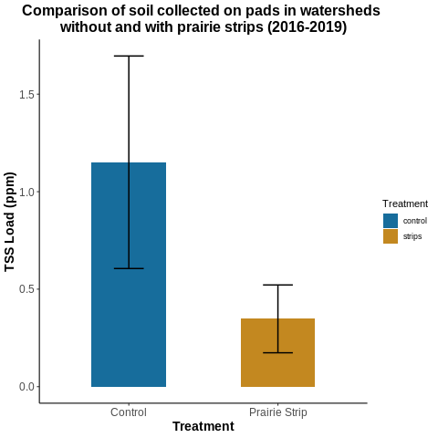
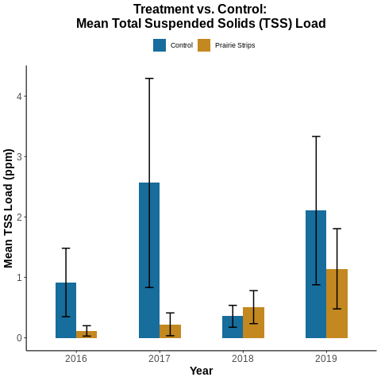
lmer(log(TSS_ppm) ~
(1 | SiteID) +
Treatment +
(1 | SiteID:Treatment) + factor(Year) * Treatment)
p = 0.0279

Slide 11
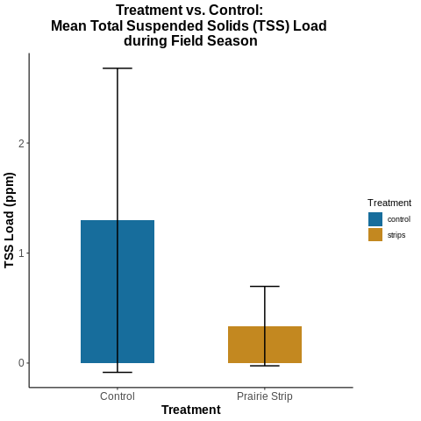
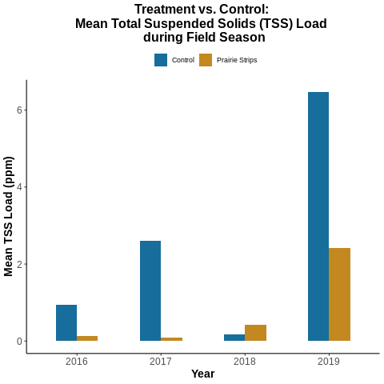
lmer(log(TSS_ppm) ~
(1 | SiteID) +
Treatment +
(1 | SiteID:Treatment) +
factor(Year) * Treatment)
p = 0.352

Slide 12
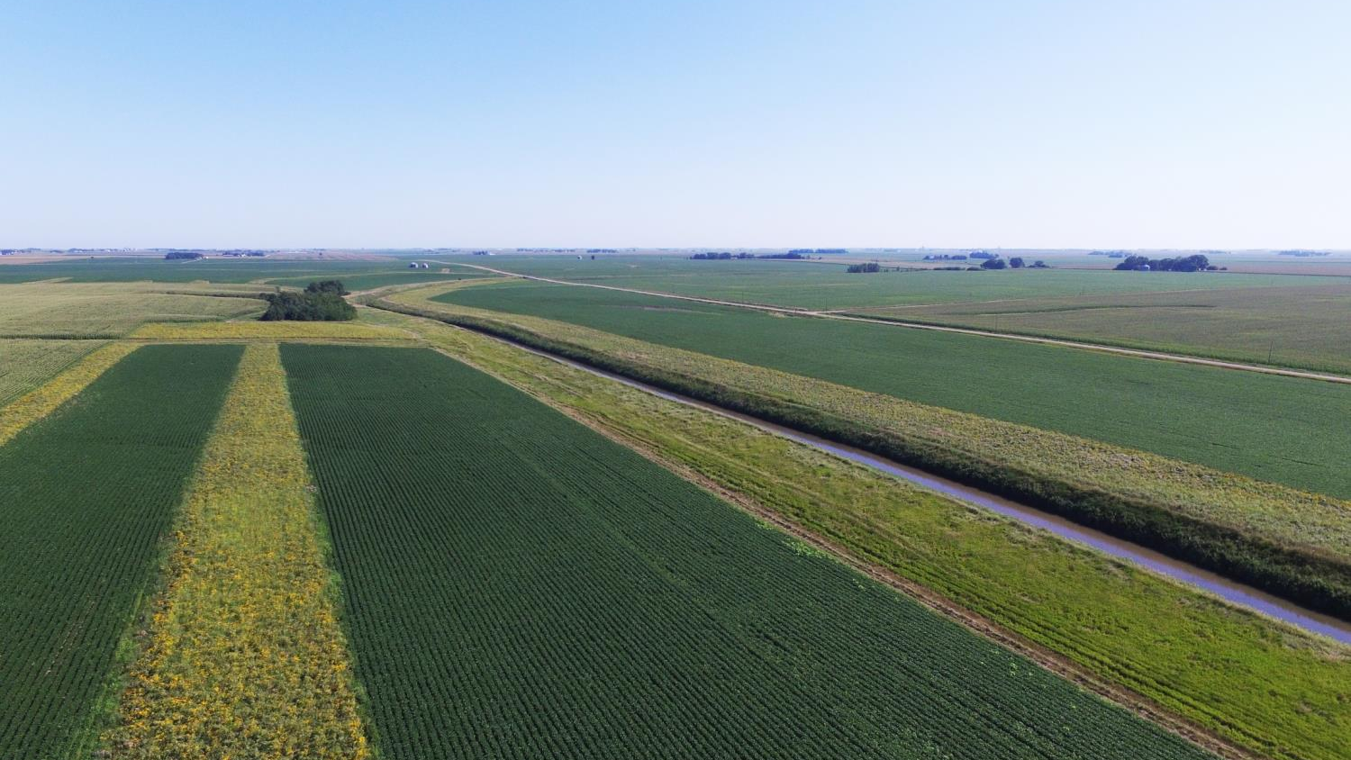
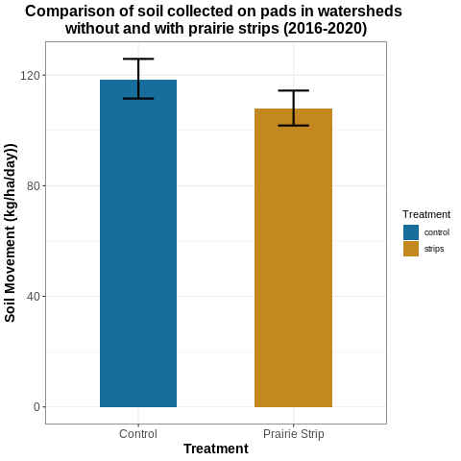
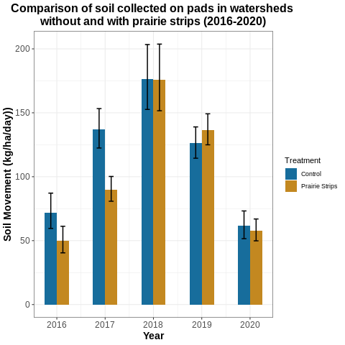
lmer(log(wpd + 0.002) ~
(1 | SiteID) + Treatment +
(1 | SiteID:Treatment) +
(1 | SiteID:Treatment:Position) + factor(Year) +
(1 | SiteID:Treatment:Position:Time) + factor(Year)*Treatment)
p = 0.4997
Year | Average Rainfall during Study (mm)
2016 | 157.6
2017 | 168
2018 | 259
2019 | 252
IA Average | 660.4 - 965.2
Notes:
All right, we have answered our question for 4 different years and the results are unreliable.
The number of sites (i.e. paired fields), changed from 4 in 2016, to 6 in 2017 and 2018, to 11 in 2019. There were a total of 12 sites monitored from 2016-2020.
This data was log transformed to calculate the average and standard deviation, then back transformed into units that are more relatable. There is a lot of variability in the datasets and we needed to adjust for that. In order to account for that variability additional investigation into erosional processes at each site and what is influencing those processes.
-Error bars – pad analysis, contrasts with estimated 95% interval
-Take out years

Slide 13
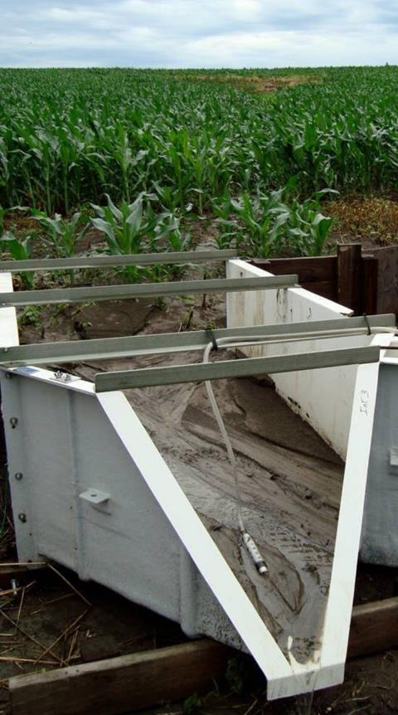
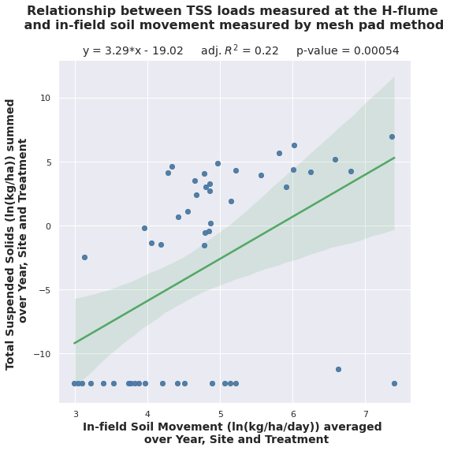
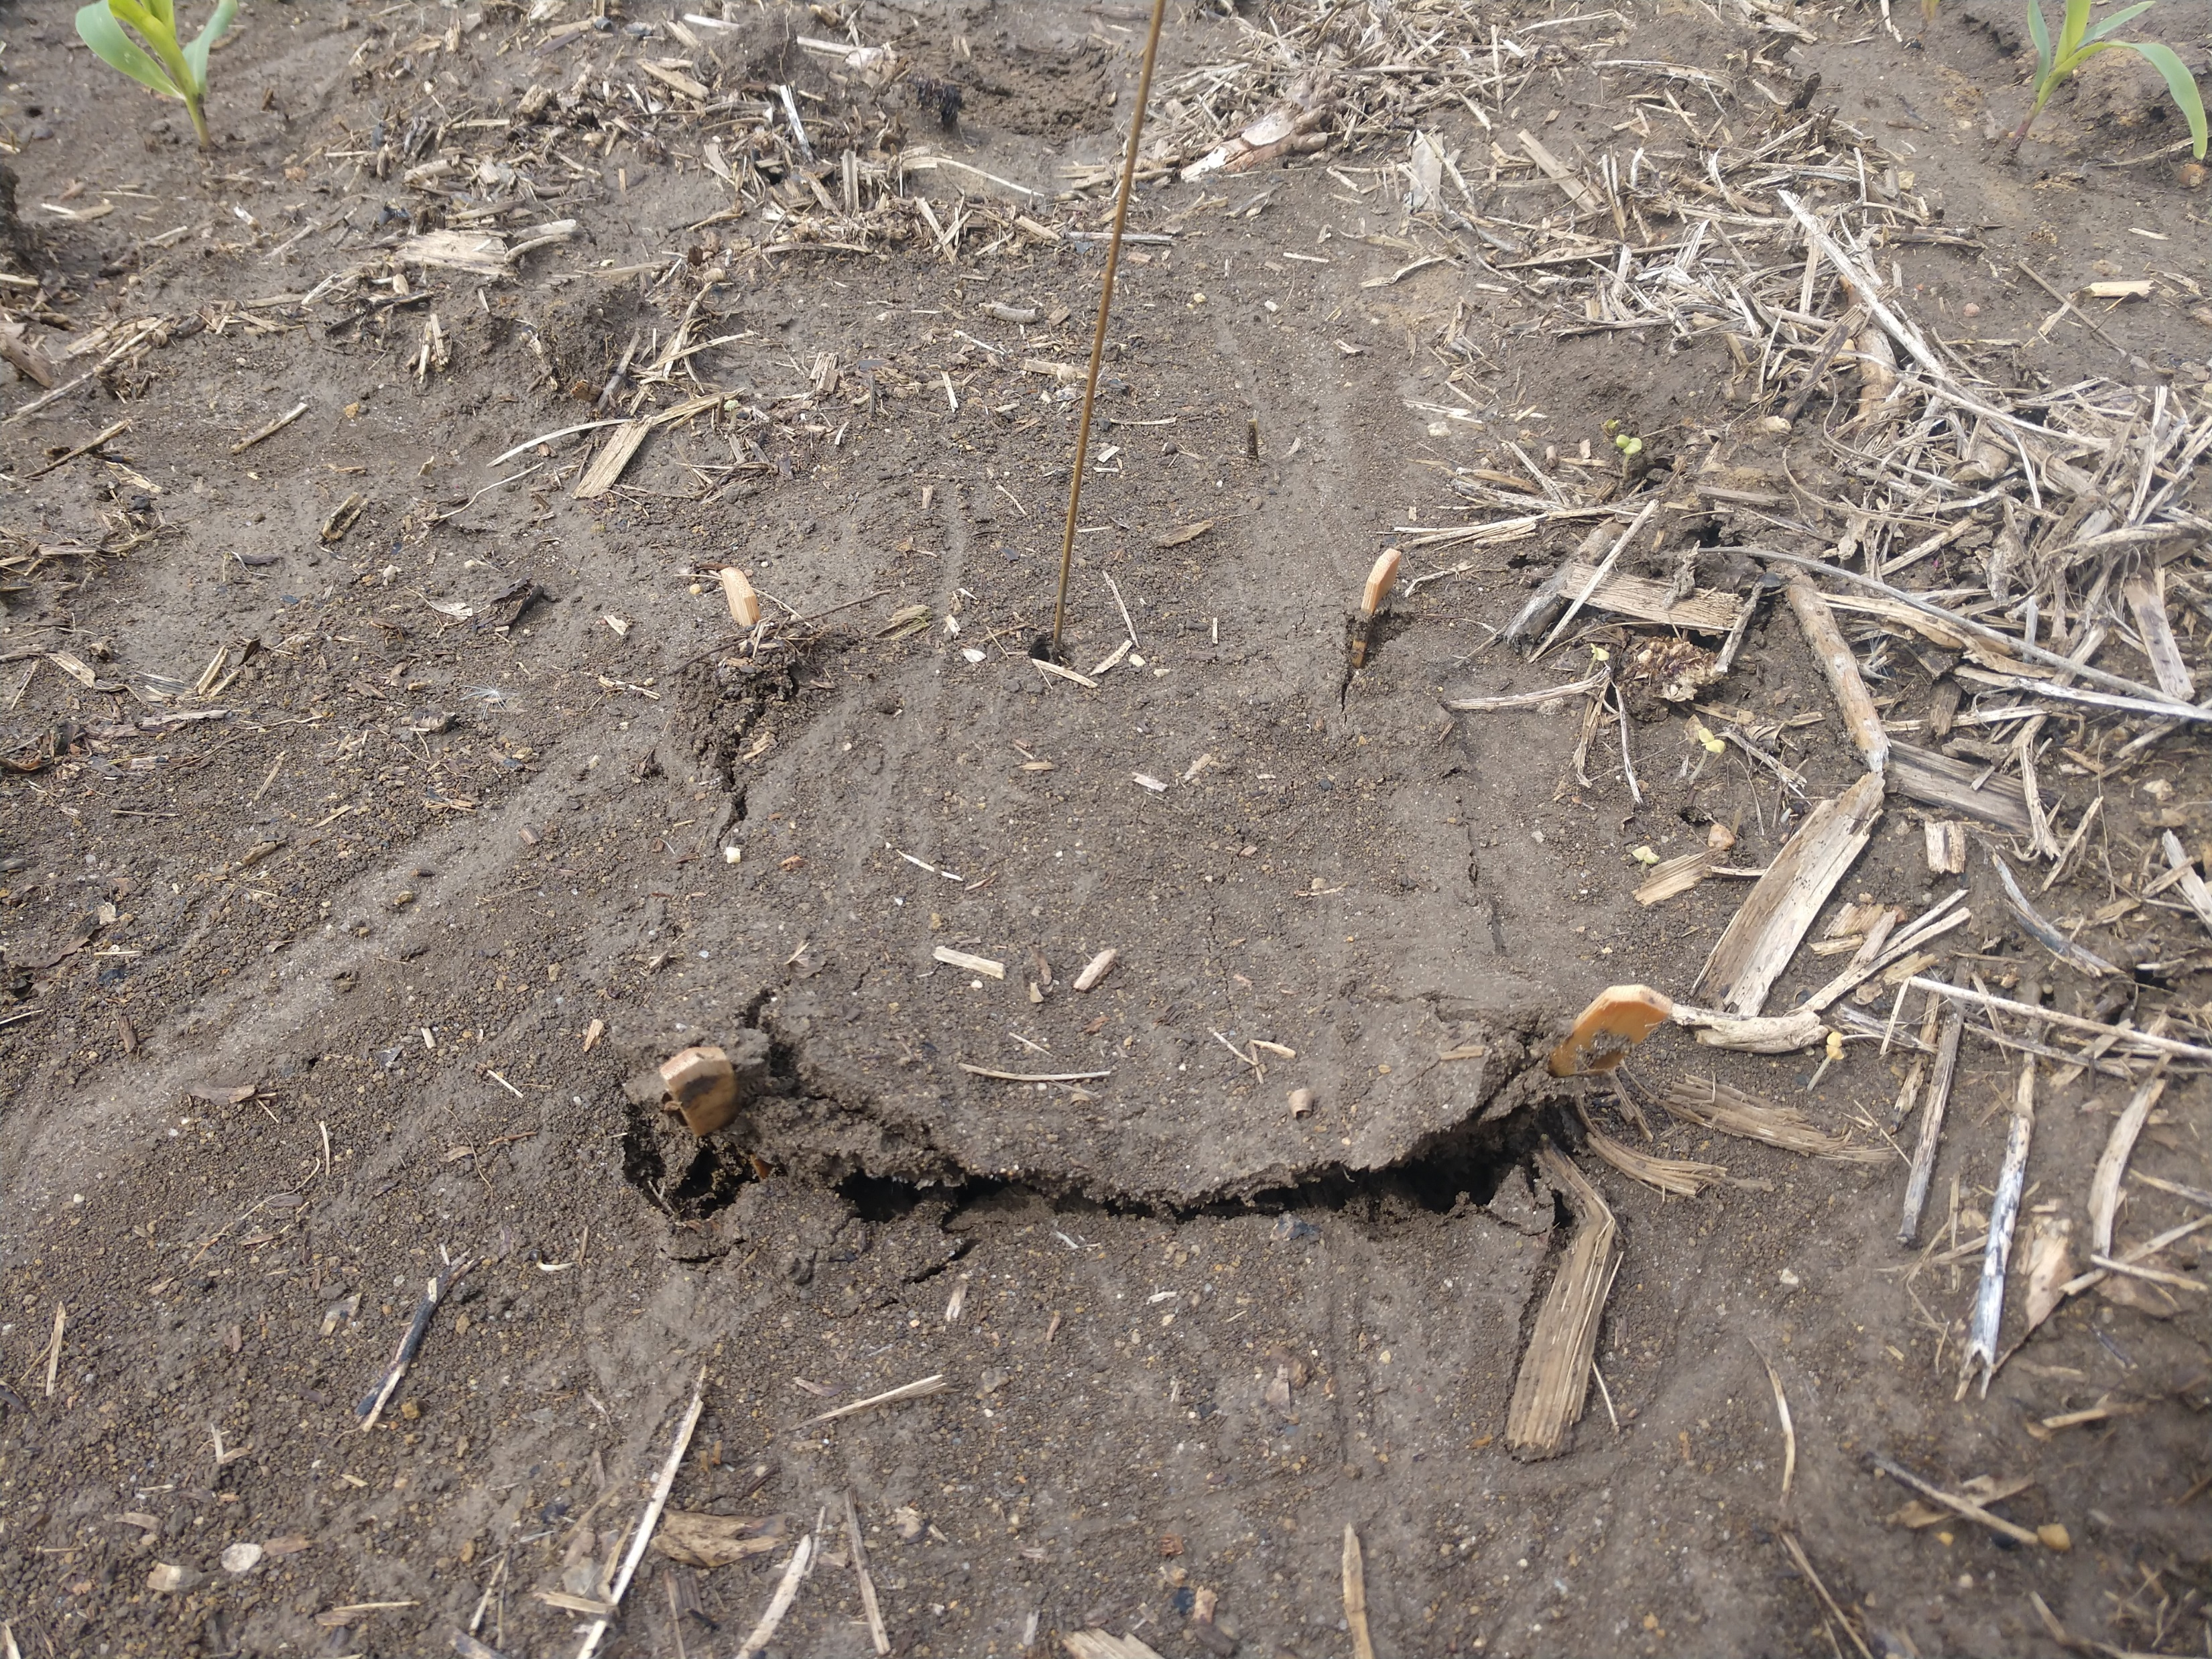
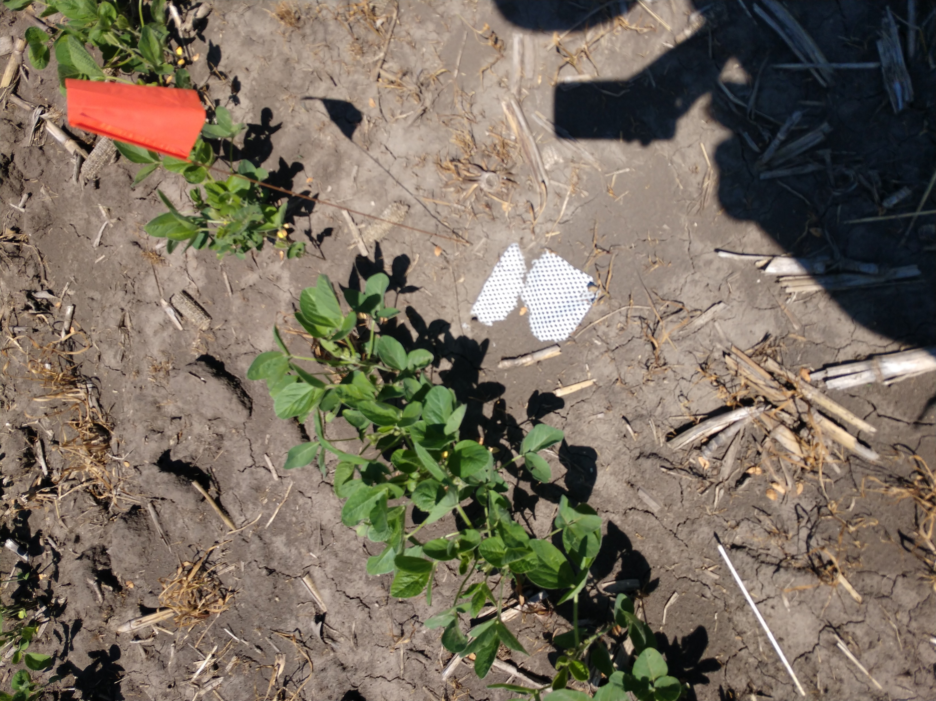
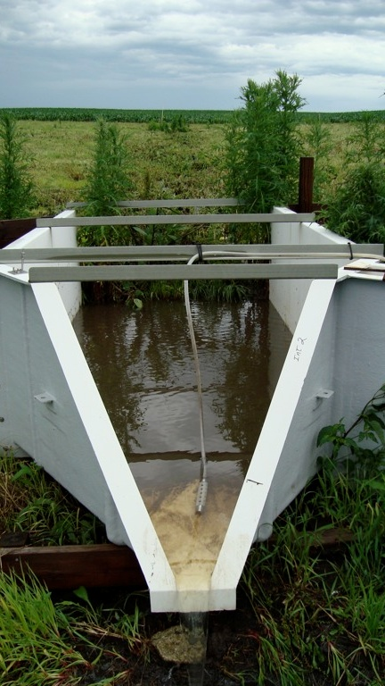
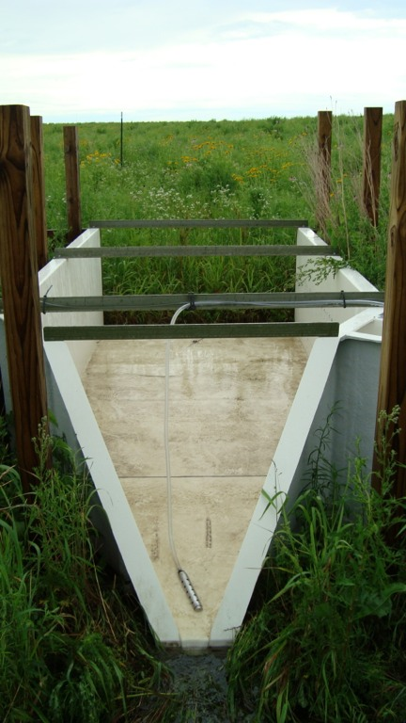
Sources: Zhou et al. 2012, Helmers et al. 2012, Hernandez-Santana et al. 2013, Iqbal et al. 2014, Mitchell et al. 2014, Zhou et al. 2014
Notes:
Explain where these numbers come from.

Slide 14
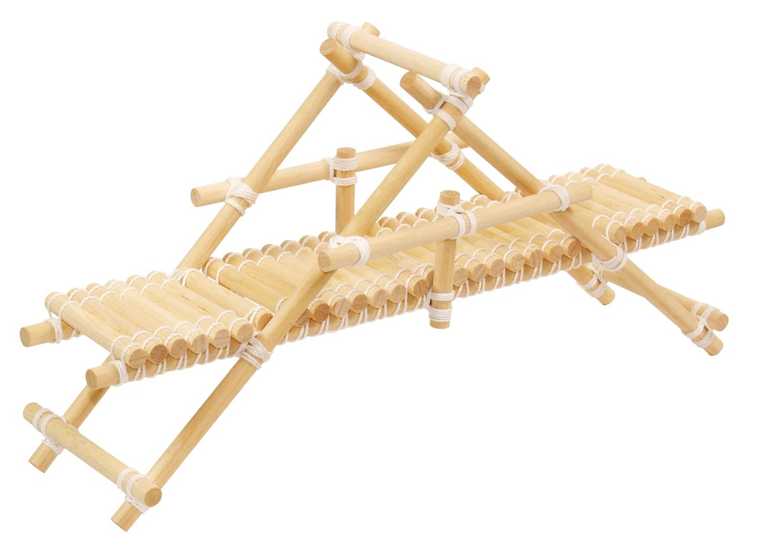
Bridging Knowledge Gaps: Soil erosion patterns and mechanisms
Within-field soil movement, as measured with mesh pad method, is strongly, positively correlated with H-flume measurements of TSS loads.
Overall, prairie strips did not have a significant effect on within-field soil movement or soil loss due to run-off during our sampling periods.
Next Steps:
Direct effect of rainfall intensity
How does this data compare to RUSLEII and WEPP estimations?
Can mesh pad data be used to update erosion calculator values in the future?
How much sediment is being deposited due to conservation practice(s)?
Notes:
Rainfall– forshadowing of results, these results are based on design of the experiment and what other covariates we are looking at
Couple bullets about method evaluation:
Bullet about paired pad analysis
Potentially less expensive and more reliable than flume datasets
So far the method has been reliable and stood up against more accepted means to measure soil erosion. There are lot of opportunities to learn about strengths and weaknesses and maybe start applying more broadly.
At the middle position, fields with prairie strips have had less movement due to

Slide 15
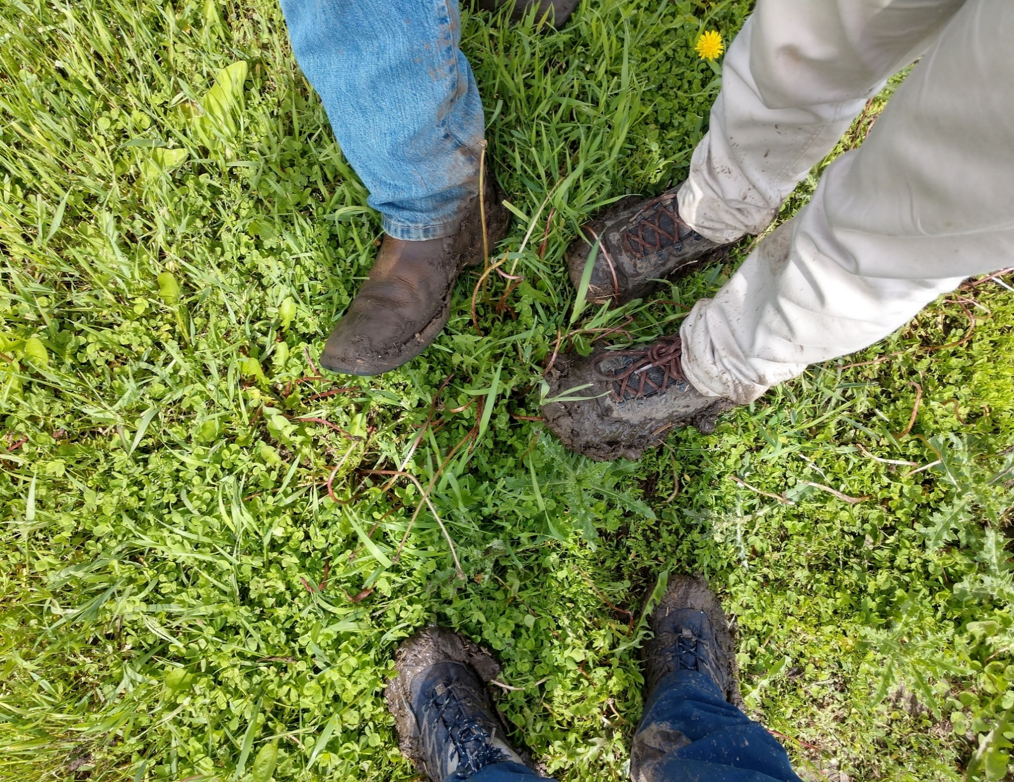
Questions?
Acknowledgements:
Tim Youngquist – Field work support and guidance. Bringing the v-diversions into reality.
Jarad Niemi – Statistical support
Katherine Goode – Statistical support
Mickala Stallman, Ángela S. Sáenz & Wyatt Westfall – Field and lab work
Chris Witte & Dr. Matt Helmers – Processing and sharing H-flume data at study sites
Rick Cruse – Planting the seed for innovation
John Tyndall – Investigating the cost-effectiveness of this method
Omar de Kok-Mercado – Coordination among STRIPS team members and research projects.
Jessica Nelson - jnel@iastate.edu
Matt Liebman mliebman@iastate.edu
Tim Youngquist timyoung@iastate.edu

Slide 16
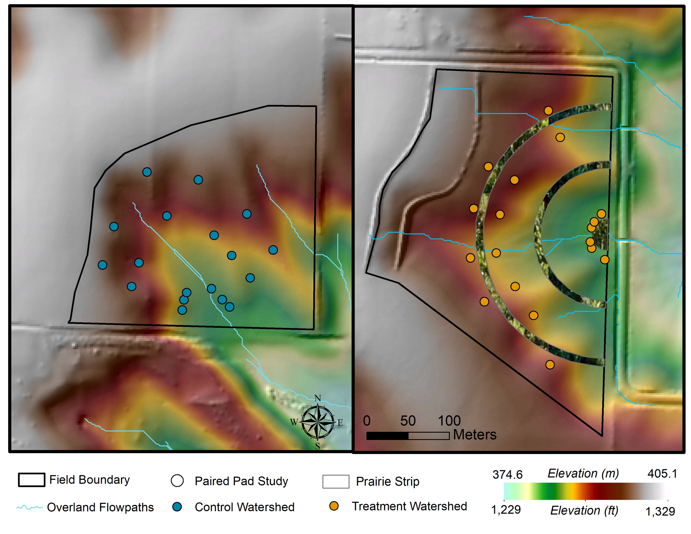
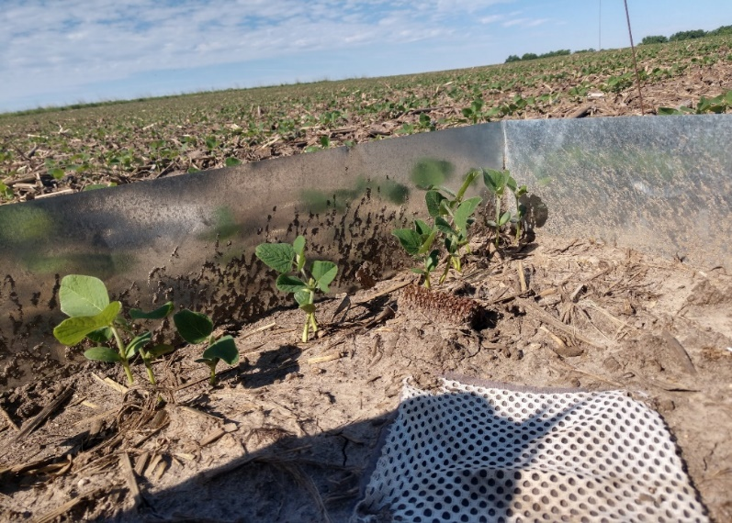
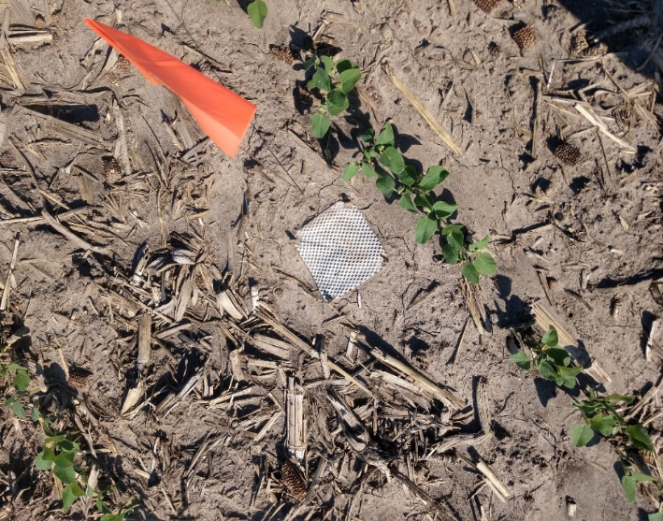
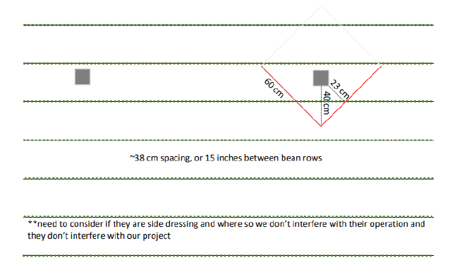
Methods: Paired Pad Study
Control
Treatment
Explore the dominant mode of soil movement observed using the mesh pad method:
-4 paired watersheds (2020)
- 3 landscape positions / watershed
- 6 paired pads / position
- 3 observational periods / paired pads
Notes:
Take out pad drainage area
Diversion dots removed
Mute DEM so it is less bright

Slide 17

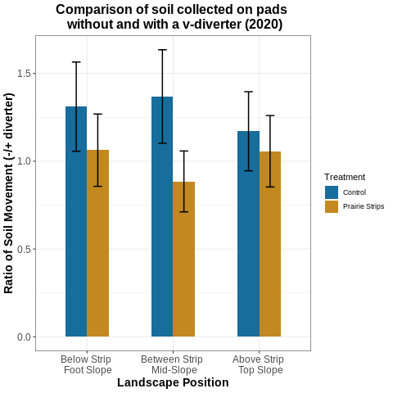
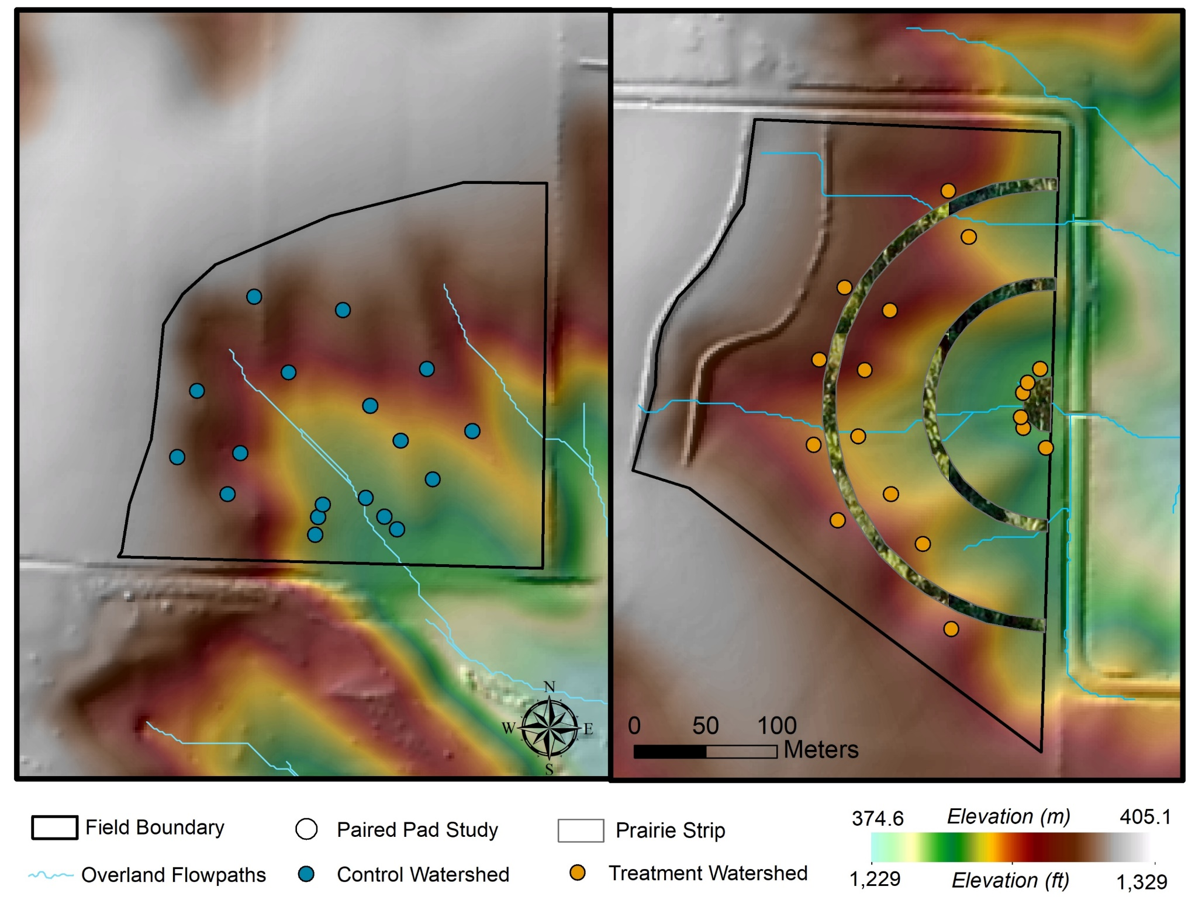


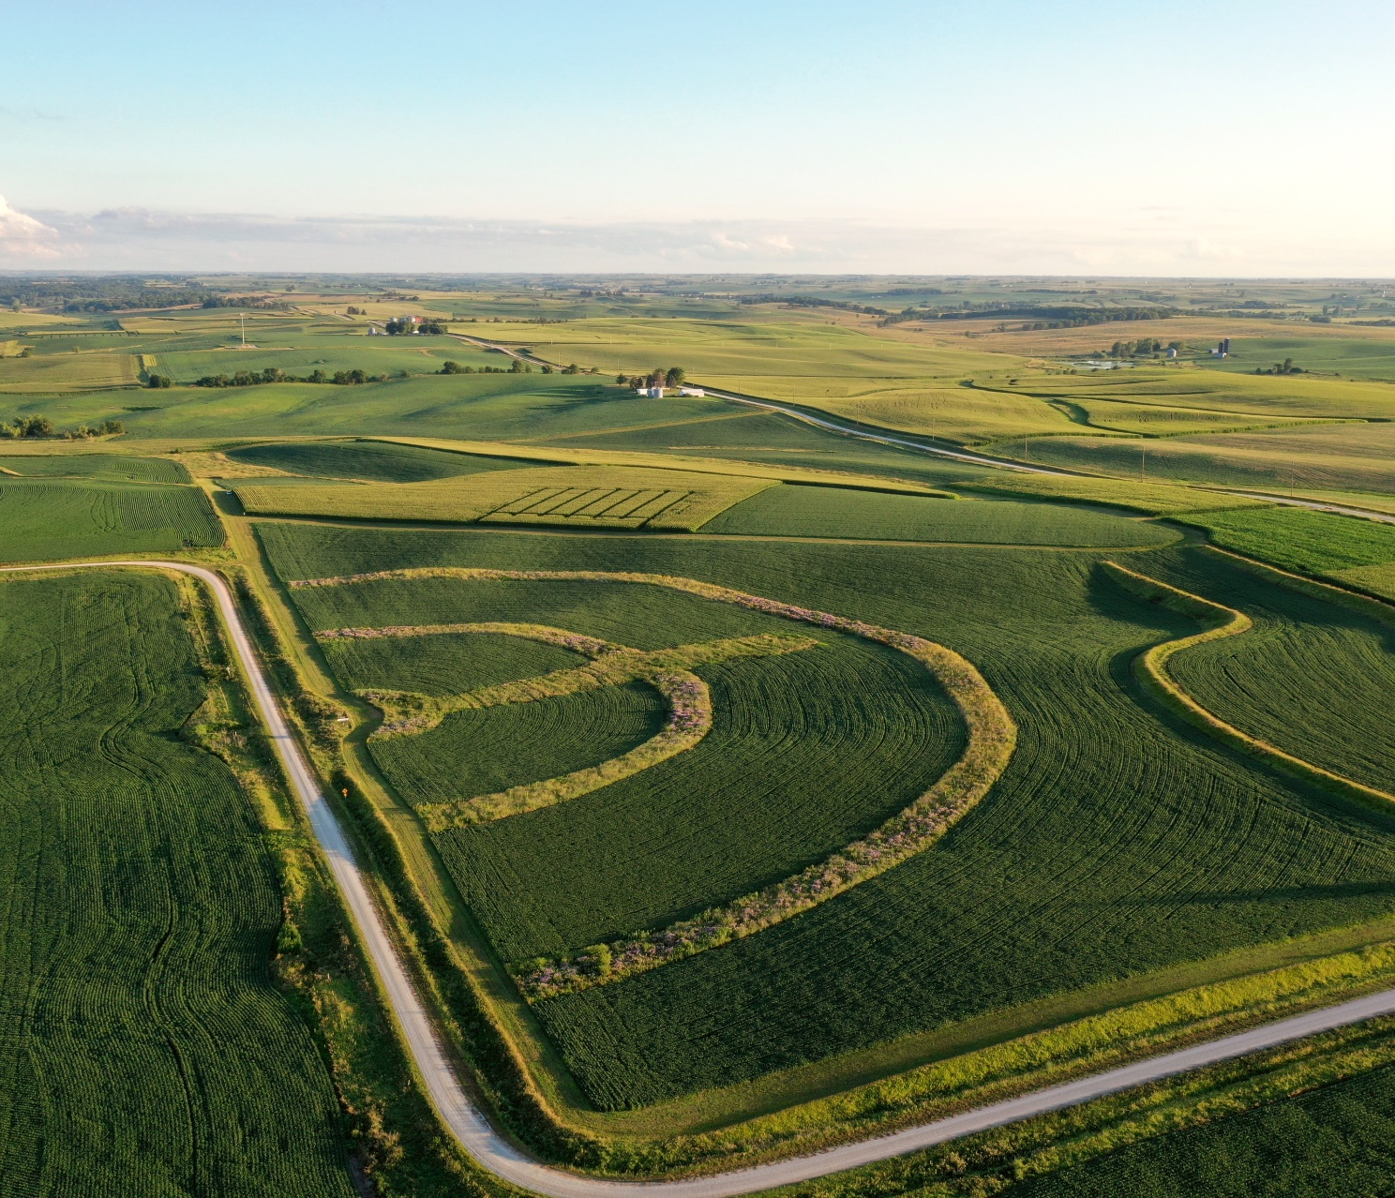
N
Notes:
In 2020 there was twice as much soil movement in fields without prairie strips, yet no statistically significant difference observed between +/- prairie strips.
The apparent interaction of prairie strips and V-diversions suggests that strips of prairie reduce soil movement due to overland flow.
Top/middle/bottom

Slide 18
Bridging Knowledge Gaps: Soil erosion patterns and mechanisms
Within-field soil movement, as measured with mesh pad method, is strongly, positively correlated with H-flume measurements of TSS loads.
Overall, prairie strips did not have a significant effect on within-field soil movement.
Use of V-diversions in 2020 revealed that at the mid-slope position prairie strips reduced the amount of in-field soil movement due to overland flow.:
1. Reduced the amount of in-field soil movement due to soil transport mechanisms, and
2. Had no affect on splash displacement of soil.
Next Steps:
Direct effect of rainfall intensity
How does this data compare to RUSLEII and WEPP estimations?
Can mesh pad data be used to update erosion calculator values in the future?
How much sediment is being deposited due to conservation practice(s)?
Notes:
Rainfall– forshadowing of results, these results are based on design of the experiment and what other covariates we are looking at
Couple bullets about method evaluation:
Bullet about paired pad analysis
Potentially less expensive and more reliable than flume datasets
So far the method has been reliable and stood up against more accepted means to measure soil erosion. There are lot of opportunities to learn about strengths and weaknesses and maybe start applying more broadly.
At the middle position, fields with prairie strips have had less movement due to

Slide 19
Make figures for subselection. Organize code.
Methods and Materials section, write it up!

